Slide 1
Pravin Ponnuri pravin.k.ponnuri.civ@mail.mil
Common Data Services Framework

Slide 2
DoD Directive 8320.02
In 2007, DoD came out with DoD Directive 8320.02 that talked about a strategic shift from isolated data in disparate networks and within legacy systems and applications to an enterprise information environment; where authorized known and authorized unanticipated users can access any information and can post their contributions for enterprise-wide access.
The directive calls for DoD components to ensure implementation of Net-Centric data sharing, including establishing appropriate plans, programs, policies, processes, and procedures in accordance with the directive.
The Army chartered CECOM, Software Engineering center to create the Army Net Centric Data Strategy Center of Excellence to help the Army implement DoD Directive 8320.02

Slide 3
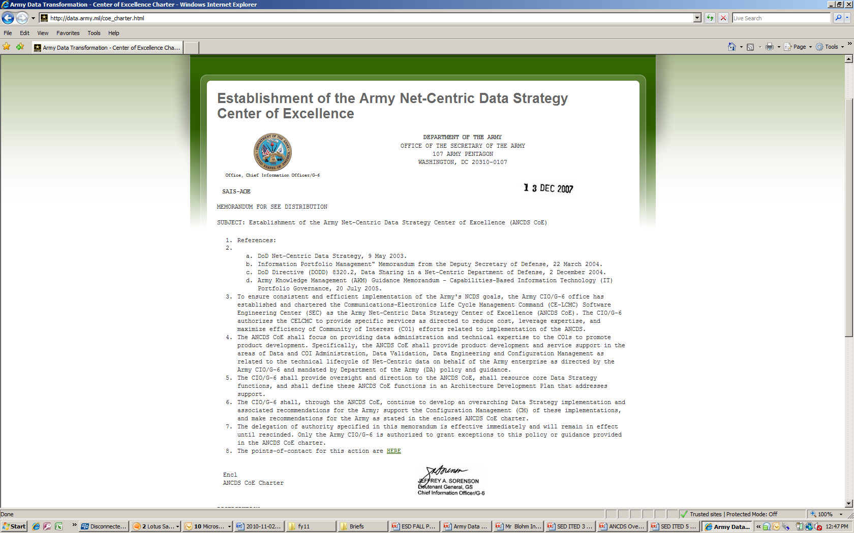
Army Net-Centric Data Strategy CoE
ANCDS CoE Mission Statement:
Function as the center of development, adoption and implementation efforts of the Army’s Net Centric Data evolution
ANCDS Center of Excellence offers
several resources:
Guidance and Best Practices
Repeatable Processes
Tools and Pilots
Subject Matter Expertise

Slide 4
What is Common Data Services Framework (CDSF)?
Common Data Services Framework (CDSF) is a framework of Tools and Services developed and maintained by ANCDS CoE.
CDSF assists in the Analysis, Design, Development, Testing, Deployment and Sustainment of secure Army & DoD compliant webservices.
CDSF helps the Army & DoD achieve its net-centricity goals.

Slide 5
Common Data Services Framework (CDSF)
T
Map Business / Mission needs to Enterprise Architecture
Identify Authoritative Data Sources
Create information exchange specifications and architectures
Data modeling and service object creation with WSDLs and Schemas
Develop Web Services
Provide automated testing and continuous integration
Compliance Assessment and Certification
Build and deploy to production
Configure production security
Final compliance assessment
SOA Monitoring and Metrics
Processes
Design
Develop
Sustain
Net Centric
SOA Standards
Standardized Web services
Artifact Generator (CDSF-AG)
Service
Security System
Standards Compliance
Test Kit (CDSF-CTK)
Tools
Usage
Agreements
Agile Development
Processes + Tools
Automated
Integration
Testing Tool
Performance / Load
Testing Tool
Static
Code
Analysis

Slide 6

What is the CDSF-Artifact Generator (CDSF-AG)?
CDSF-AG is a rapid data service development tool that provides solutions for your data strategy and data service needs
CDSF-AG reduces the time to start a new service development project through automated development environment creation
CDSF-AG assists developers in defining their web services in compliance with Army and DoD Standards
CDSF-AG generates code to be used with the best of breed commercial and open source technology
Notes:
Now we’re going to discuss the Common Data Services Framework, or CDSF.
What is CDSF?
1st bullet: CDSF is a data service development tool that provides solutions for your data strategy and data service needs.
1st sub-bullet: It’s a rapid service development solution that provides an implementation framework and a run-time library.
2nd sub-bullet: It also provides a software development toolkit for building secure web services.
CDSF builds services that are SOA efficient and compliant to Army standards and the Army and DoD vision for a net-centric, common data sharing environment.

Slide 7
What can CDSF-AG do for me?
CDSF-AG provides automated end-to-end web services development tool chain for re-usable software assets and faster project on-boarding
Adopters choose one or more
Service Artifacts
Development Environment
Security Framework
Service Framework
Re-usable Components
Generate WSDL
Generate Schema
Composed standards
Visual Studio (C#)
Eclipse (Java)
Builds
Unit Test
STIG Security Impl
Encryption Handling
Certificates / PKI
OCSP
Authentication and
Authorization
Security Proxy
Windows Communication Foundation (WCF)
Service Component Architecture (SCA)
JAX-WS
Apache Axis, CXF, etc
UCore Helper
Pubsub API
Logging

Slide 8
CDSF-AG Automates Start of Development
Need to develop
a new Web Service
Define Service
Spec (WSDL, Schema, etc)
Create Development
Environment
Run code generator on WSDL and Schema
Add Security to Service
Framework
Configure Service Framework
Select Service Framework
Months
To Minutes
Configure
Unit Test
Implement
Web Service Stub
Validate basic
Message Exchange
Start
Business Logic Development
CDSF-AG Automates this manual process to reduce ramp up

Slide 9
What technologies does CDSF-AG support?
Programming Languages:
Java, C# (.NET)
Service standards:
DSL-A, CDR, WS-Notification, Universal Core, DoD Metadata Specification (DDMS), NIEM
Implementation Standards:
JAX-WS, Apache Tuscany, Apache CXF, Spring, WCF, and other web service frameworks
Interop on Tomcat, Jboss, WebLogic, WebSphere, OC4J, etc
Service Security standards
WS-Security, SAML, OCSP, WS-Trust, DISA/NCES, etc

Slide 10
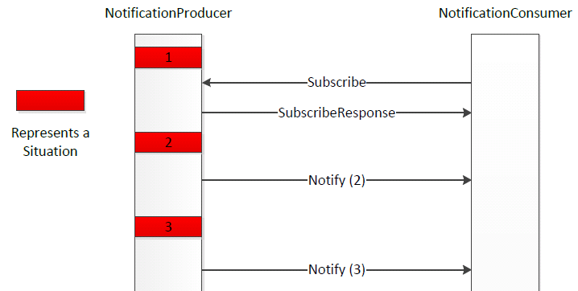
CDSF-AG Provides Light weight Pubsub
WS-Notification light weight implementation
Java and C#
No ESB or middleware required - optional
Full spec implementation
Push style notification
Pull style notification
Full control over complete message and subscription state

Slide 11
CDSF-AG vs other commercial products
Why would I choose CDSF-AG over other generator products such as wsdl2java ?
CDSF-AG assists in creating web services consistent with Army and DoD standards, such as DSL-A, UCore, and CDR
CDSF-AG provides automated WSDL and Schema creation from an interactive data driven wizard, ensuring service definitions remain consistent and error free
CDSF-AG provides end to end development environment generation, decreasing time to start off a new service development project
CDSF-AG provides the framework choices and integration, pre-packaged and pre-configured to reduce service selection and evaluation, ensuring implementation standards are portable (e.g. same code can use different service frameworks)

Slide 12
CDSF – Compliance Test Kit (CTK)
CDSF-Compliance Test Kit (CTK) provides users with an easy way to validate WSDLs and XML schemas against various Army and DoD specifications to ensure compliance. It also provide an easy to read non-compliance report with recommended corrective actions.

Slide 13
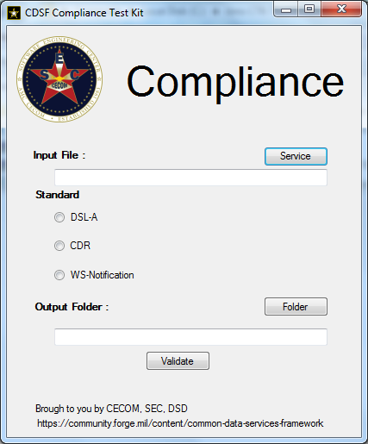
CDSF-CTK GUI

Slide 14
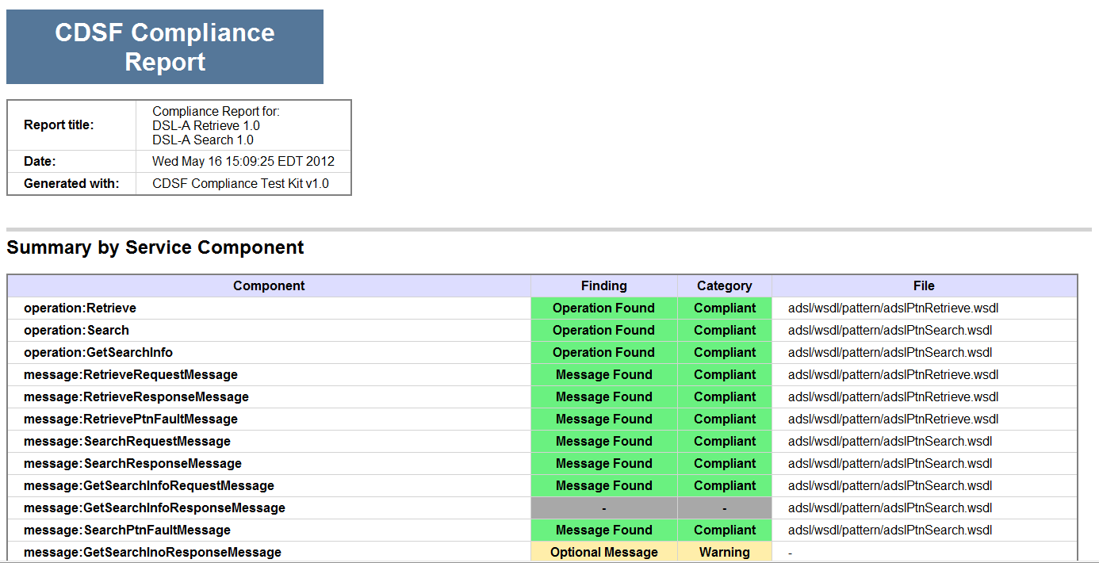
CDSF-CTK Report

Slide 15
CDSF- Security Proxy (SP)
CDSF Security Proxy provides a security layer over existing unsecure web services enabling them to communicate with other secure web services by stripping the security layer from incoming messages and adding a security layer to outgoing messages.

Slide 16
What are the other benefits of using CDSF?
Provides GOTS software products, e.g. CDSF-AG, CDSF-CTK, CDSF-Proxy Service, Tactical Service Security System (TS3)
Eases the migration to net-centricity by using best of breed open source and commercial technology
Accelerates the net-centric implementation of Army, DoD and other Government standards
Ensures DoD security with configurable security solutions
Saves time and money by reducing the data service development time from weeks to days or hours
Notes:
CDSF supports the transition to net-centricity and Army single enterprise.
1st bullet: CDSF compliments standard development environments and developer best practices for both .NET and Java.
2nd bullet: CDSF focuses on implementing DoD and Government standards. CDSF ensures full compliance with Army and DoD standards and requirements, because compliance standards are integrated into the functionality of the tool.
CDSF leverages and implements:
Data Services Layer – Army (DSL-A)
Universal Core (UCore – DoD standard XML)
DoD Metadata Specifications (DDMS)
Security Technical Implementation Guidelines (STIG)
DoD Content Discovery and Retrieval (this is a new feature for FY11)
3rd bullet: The CDSF toolkit has security measures integrated into its development processes.
CDSF implements security models:
(STIG) Compliant Security – this is built-in and pre-configured for immediate testing.
CDSF includes the Tactical Security Services System (TS3) for service security.
4th bullet: CDSF saves both time and money. Developers no longer need to write custom code to satisfy standards/constraints of Enterprise Service Standards. CDSF reduces the development skill set that is required. There is no need bootstrap code. Code that complies with standards is generated by the tool. Its development time tools support entry level service developers.
Time and money are also saved as legacy systems are able to remain in place. As CDSF compliments both .NET and Java development environments, so it precludes the need to alter or replace any existing systems if SOA principles are followed.

Slide 17
Clients using CDSF
U.S. Army Public Health Command (USAPHC)
Medical Protection System (MEDPROS)
Condition Based Maintenance Plus (CBM+)
C2 Data Sharing Pilot (DDS/PASS, JC3IEDM)
Enterprise Management Decision Support (EMDS)
Drug Alcohol Management Information System (DAMIS)
Defense Causality Information Processing System (DCIPS)
Army Human Resources Database (ITAPDB)
Army Training Requirements and Resource System (ATRRS)
Army Central Registry (ACR)
Army Centralized Operations Police Suite (COPS)
Criminal Investigation Division (CID) Information Management System (CIMS)
Notes:
1st bullet: CDSF accelerated the development process for the US Public Health Command, MEDCOM (Medical Protection System), resulting in a savings of 18+ months of staff work (Health Promotion Risk Reduction)
3rd bullet: US and Coalition forces demonstration, including an Android mobile demonstration. This was accomplished in three days.

Slide 18
Contact Information
Pravin Ponnuri
CECOM SEC, Data Services Division
Army Net Centric Data Strategy Center of Excellence
(ANCDS CoE)
Comm: 443-861-8493
pravin.k.ponnuri.civ@mail.mil
www.sec.army.mil
CDSF on Forge.mil: https://software.forge.mil/sf/projects/common_data_services_framework
Warfighter Superiority and Information Dominance

